Slide 1





Zhoom
Members: Acharon, Alesna, Florida, Oquias

Slide 2
LANDING PAGE

Slide 3
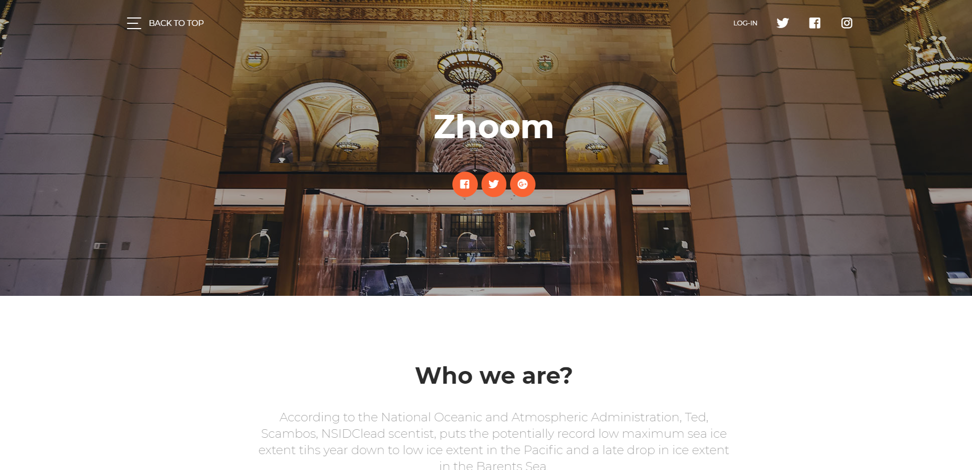
LANDING PAGE

Slide 4
SIGN UP

Slide 5
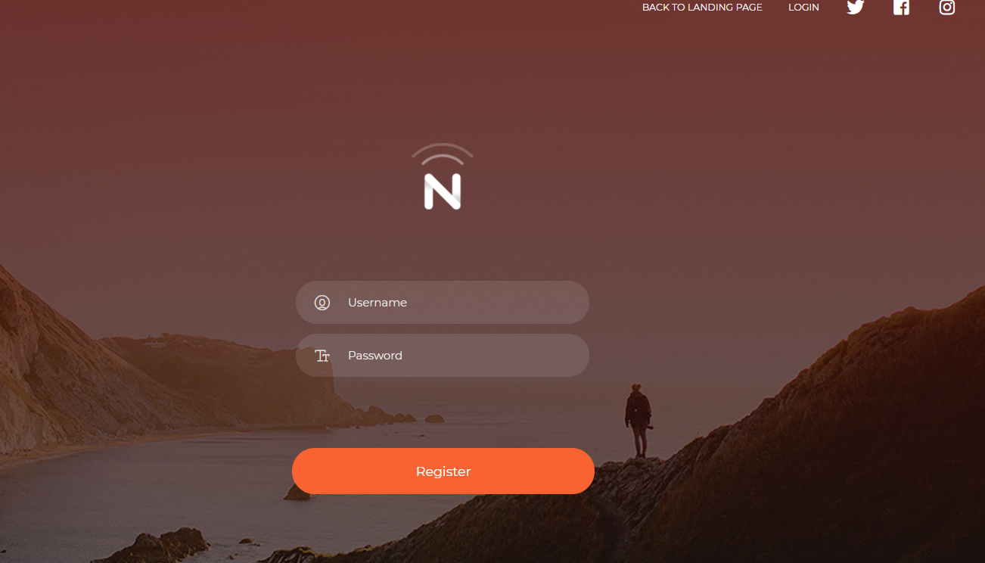
SIGN UP PAGE
WHERE ALL USERS WILL REGISTER.

Slide 6
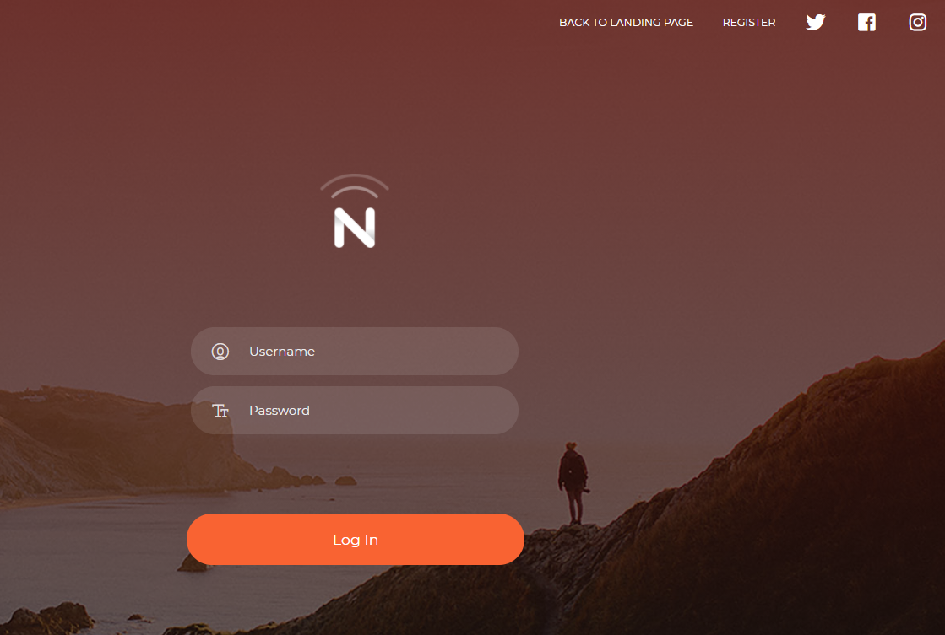
LOG IN PAGE

Slide 7
USERS

Slide 8
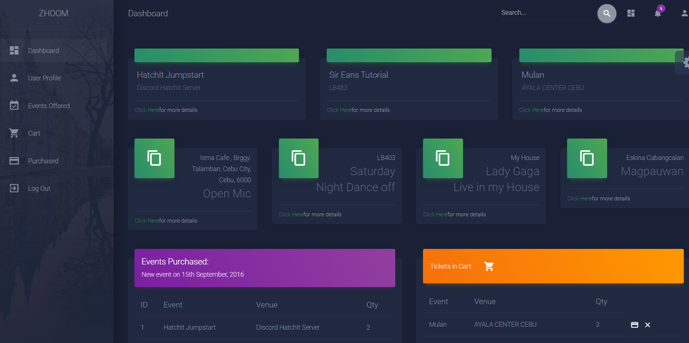
DASHBOARD PAGE
AFTER THE USER HAS LOGGED IN, THE PERSON WILL BE REDITECTED TO THE DASHBOARD, WHERE THE LIST OF EVENT WILL BE SHOWN

Slide 9
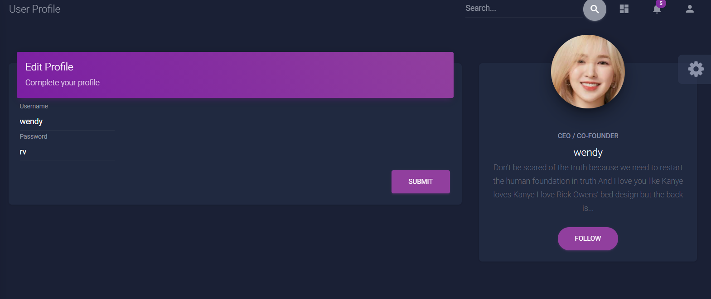
USER PROFILE PAGE
USER PROFILE IS WHERE THE USER WILL EDIT AND VIEW THEIR PROFILE

Slide 10
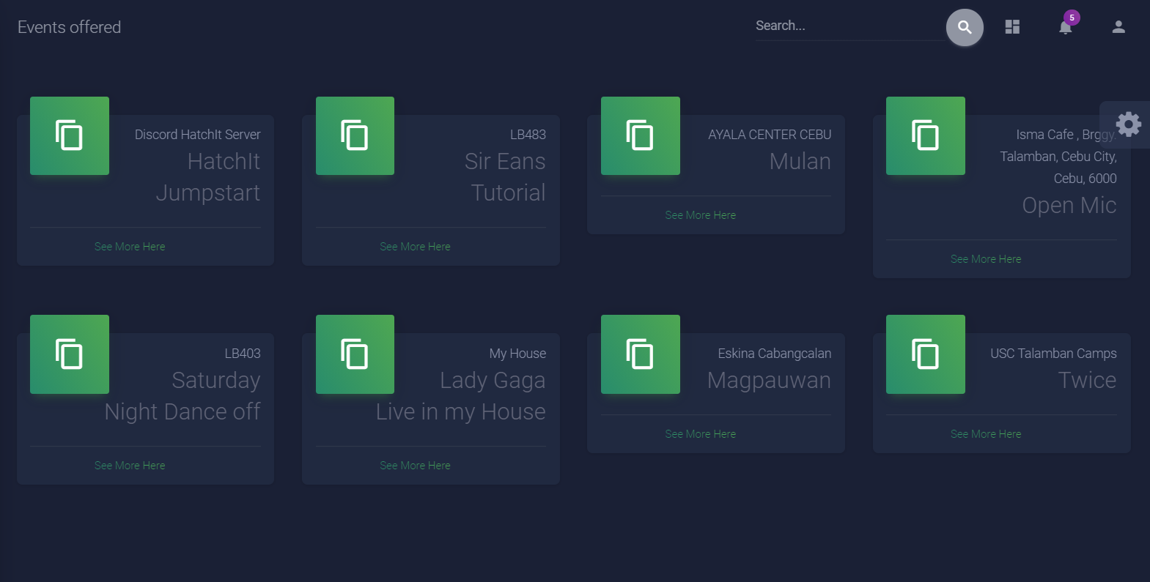
EVENTS PAGE
EVENTS PAGE IS WHERE THE EVENTS CAN BE SEEN

Slide 11
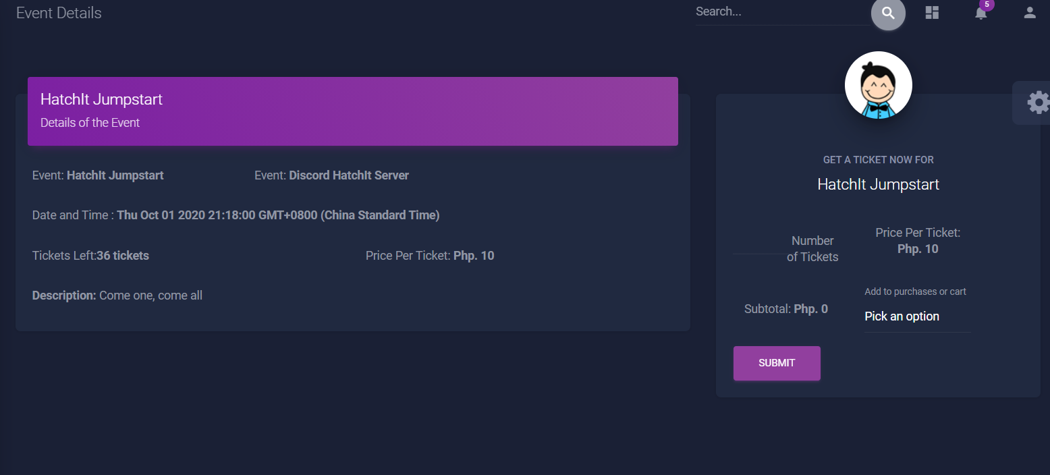
EVENTS DETAILS
THIS PAGE IS WHERE THE USER SEES THE DETAILS OF THE EVENT AND WHERE THEY CAN PURCHASE THE EVENT

Slide 12
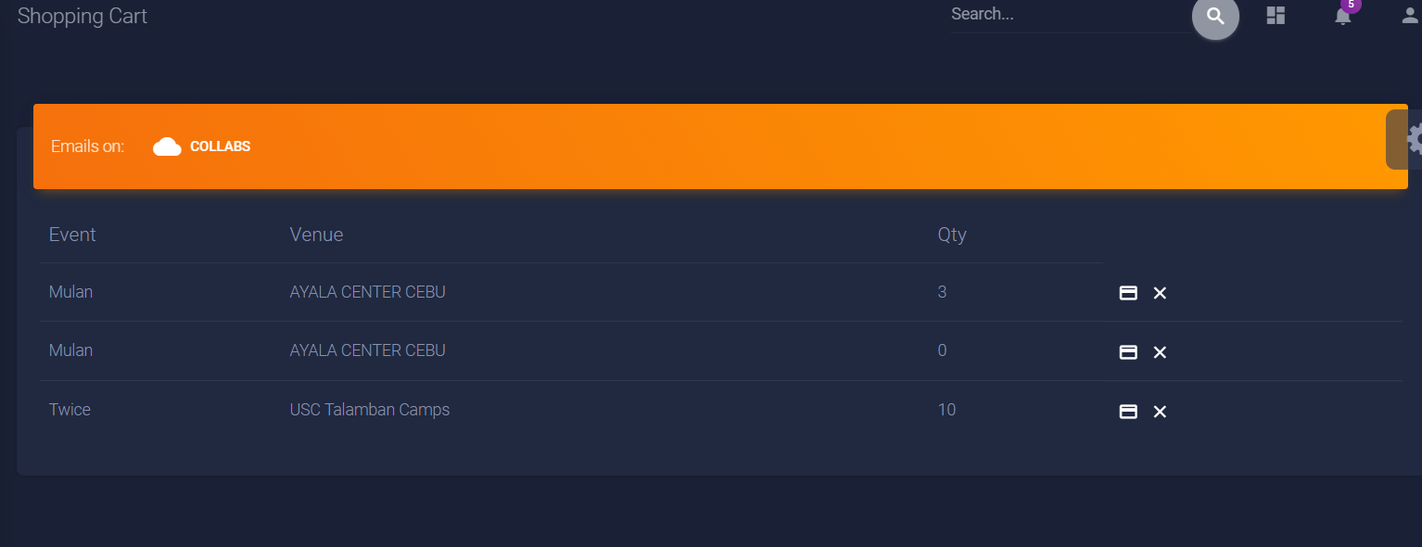
SHOPPING CART PAGE
CART PAGE IS WHERE THE USER STORES THE EVENT THEY WOULD LIKE TO BUY. ONCE THE CARD ICON HAS BEEN CLICKED THAT MEANS THAT THE USER HAS BOUGHT THE TICKET

Slide 13
SHOPPING CART PAGE
CART PAGE IS WHERE THE USER STORES THE EVENT THEY WOULD LIKE TO BUY. ONCE THE CARD ICON HAS BEEN CLICKED THAT MEANS THAT THE USER HAS BOUGHT THE TICKET

Slide 14
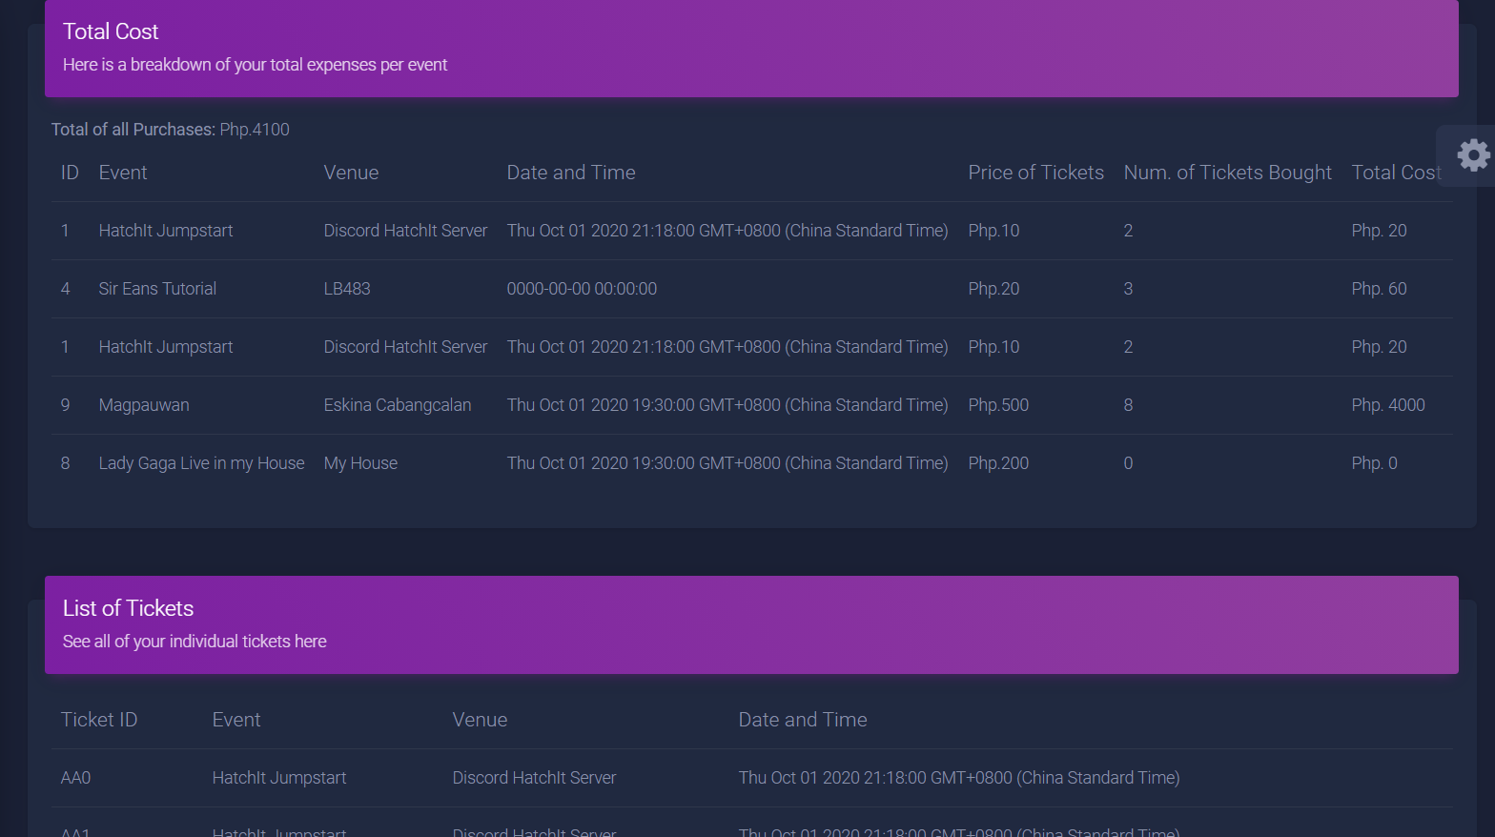
PURCHASED PAGE
THIS PAGE IS WHERE THE USER CAN SEE WHAT EVENT THEY HAVE PURCHASED

Slide 15
ADMIN

Slide 16
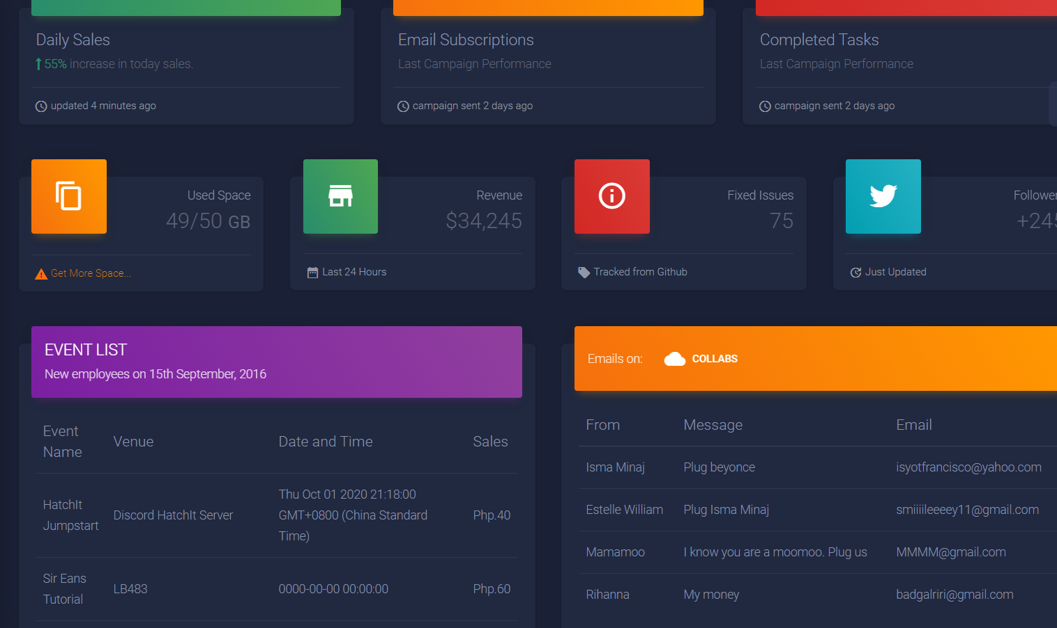
DASHBOARD
THIS PAGES SHOWS THE ADMIN THE TOTAL SALES, EVENT LIST AND COLLABORATIONS

Slide 17
USER PROFILE PAGE
USER PROFILE IS WHERE THE USER WILL EDIT AND VIEW THEIR PROFILE

Slide 18
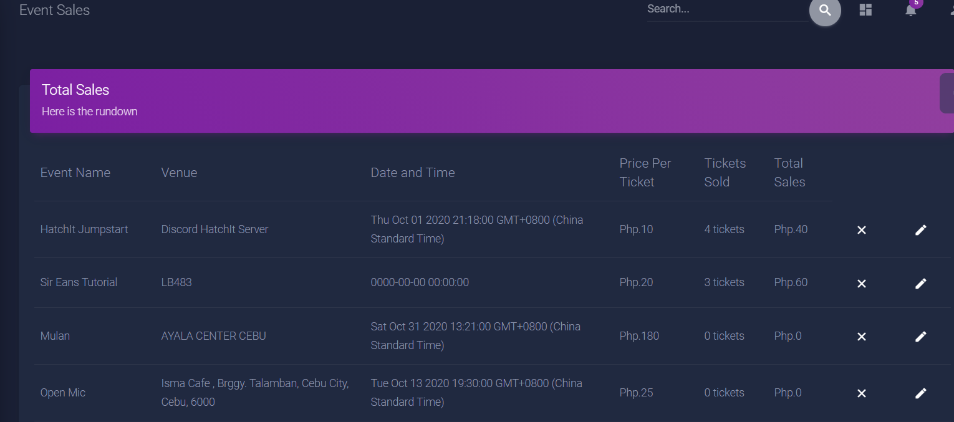
EVENT PAGE
THIS IS WHERE THE USER CAN SEE THE EVENTS, MAKE THE EVENTS, AND EDIT THE EVENTS

Slide 19
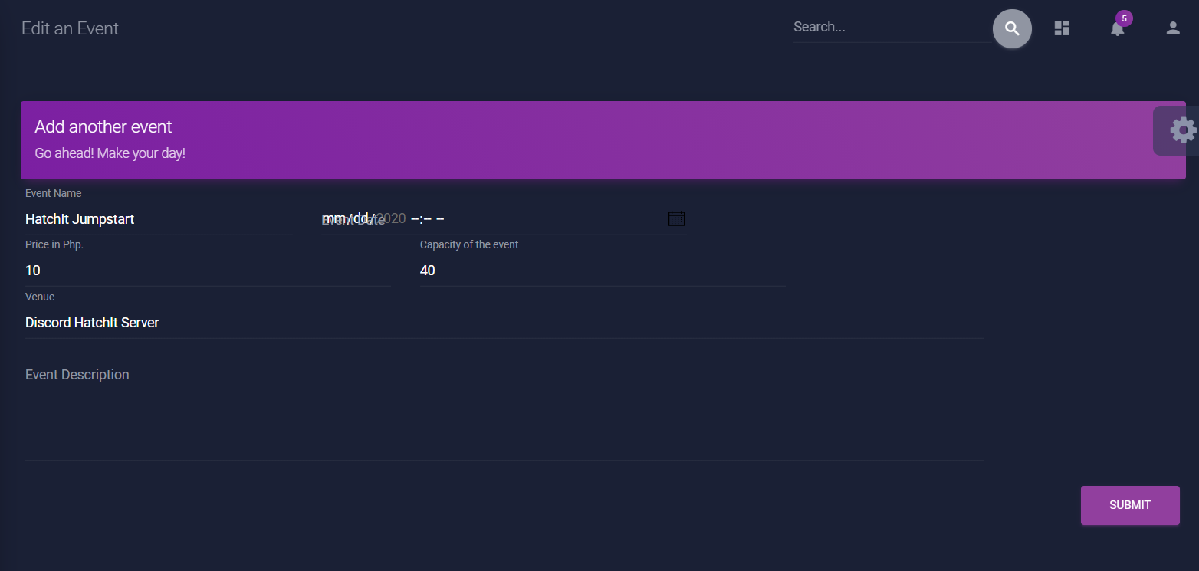
EDIT EVENT PAGE
THIS IS WHERE THE USER EDITS THE EVENTS

Slide 20
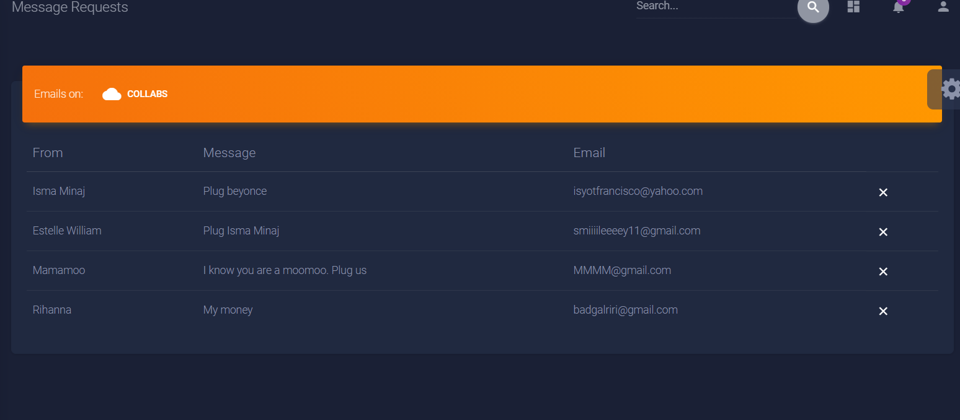
EDIT EVENT PAGE
THIS IS WHERE THE USER SEES THE WHO THEY ARE COLLABORATING WITH

Slide 21
END

